Slide 1
Are Word Embedding-based Features Useful for Sarcasm Detection?
Aditya Joshi, Vaibhav Tripathi, Kevin Patel, Pushpak Bhattacharyya, Mark Carman
(2016)

Slide 2
Introduction
Sarcasm(讥讽)
a form of verbal irony that is intended to express contempt(轻视) or ridicule(嘲笑).
Linguistic studies show that the notion of context incongruity is at the heart of sarcasm (Ivanko and Pexman, 2003).
A popular trend in automatic sarcasm detection is semi-supervised extraction of patterns that capture the underlying context incongruity (Davidov et al., 2010; Joshi et al., 2015; Riloff et al., 2013)
Rely on sentiment-bearing words and may not capture nuanced(细微差别) forms of sarcasm.
e.g. ‘With a sense of humor like that, you could make a living as a garbage man anywhere in the country.’
In this paper, we explore use of word embeddings to capture context incongruity in the absence of sentiment words.

Slide 3
Motivation
‘A woman needs a man like a fish needs bicycle’
Use word vector similarity scores
Consider similarity scores (as given by Word2Vec) between two pairs of words in the sentence above:
similarity(man,woman) = 0.766
similarity(fish,bicycle) = 0.131
This semantic discordance can be a clue to presence of context incongruity

Slide 4
Background: Features from prior work
Liebrecht et al. (2013)
Unigrams, bigrams and trigrams as features
Gonzalez-Ibanez et al. (2011a)
Unigrams
Dictionary-based
words from LIWC (a lexical resource) that have been annotated as emotion and psychological process words
Buschmeier et al. (2014), in addition to unigrams,
(a) Hyperbole (captured by three positive or negative words in a row)
(b) Quotation marks and ellipsis (省略)
(c) Positive/Negative Sentiment words followed by an exclamation mark or question mark
(d) Positive/Negative Sentiment Scores followed by ellipsis (represented by a ‘...’)
(e) Punctuation (f) Interjections (g) Laughter expressions.
Joshi et al. (2015), in addition to unigrams,
Implicit incongruity features: patterns with implicit sentiment as extracted in a pre-processing step
Explicit incongruity features: number of sentiment flips, length of positive and negative subsequences and lexical polarity.

Slide 5
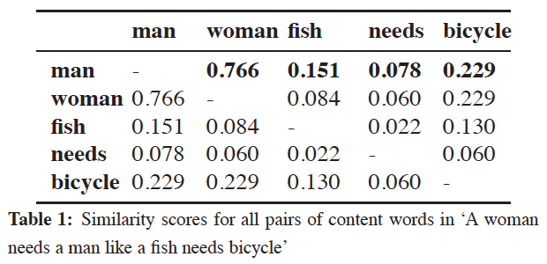
Word Embedding-based Features
The similarity score is the cosine similarity between vectors of two words. To illustrate our features, we use our example ‘A woman needs a man like a fish needs a bicycle ’.

Slide 6
Word Embedding-based Features
Unweighted similarity features (S)
Compute similarity scores for all pairs of words (except stop words)
Return four feature values per sentence:
Maximum score of most similar word pair
value 0.766 derived from the man-woman pair
Minimum score of most similar word pair
Maximum score of most dissimilar word pair
Minimum score of most dissimilar word pair

Slide 7
Word Embedding-based Features
Distance-weighted similarity features (WS)
Compute similarity scores for all pairs of words (excluding stop-words)
Divide them by square of distance between the two words
the similarity between terms that are close in the sentence is weighted higher
Maximum distance-weighted score of most similar word pair
Minimum distance-weighted score of most similar word pair
Maximum distance-weighted score of most dissimilar word pair
Minimum distance-weighted score of most dissimilar word pair

Slide 8
Experiment Setup
Dataset
Quotes on GoodReads
GoodReads describes itself as ‘the world’s largest site for readers and book recommendations.’
Download
quotes with the tag ‘sarcastic’ as sarcastic quotes
quotes with the tag ‘philosophy’(哲理) as non-sarcastic quotes
labels are based on these tags given by users
Result
3629 quotes
out of which 759 are labeled as sarcastic.
This skew is similar to skews observed in datasets on which sarcasm detection experiments have been reported in the past (Riloff et al., 2013).

Slide 9
Experiment Setup
Evaluation
F-score
Precision
Recall
Classification
SVM_{perf}
Support Vector Machine for Multivariate Performance Measures by Joachims (2006)
http://www.cs.cornell.edu/people/tj/svm_light/svm_perf.html
with c as 20, w as 3, and loss function as F-score optimization
five-fold cross-validation

Slide 10
Experiment Setup
For each of the four papers, we experiment with four configurations:
Features given in paper X
Features given in paper X + unweighted similarity features (S)
Features given in paper X + weighted similarity features (WS)
Features given in paper X + S + WS

Slide 11
Experiment Setup
Four types of word embeddings
LSA
reported in Landauer and Dumais (1997): http://www.lingexp.uni-tuebingen.de/z2/LSAspaces/
vocabulary size: 100,000
GloVe
GloVe project: http://nlp.stanford.edu/projects/glove/
vocabulary size: 2,195,904
Dependency Weights
given in Levy and Goldberg (2014): https://levyomer.wordpress.com/2014/04/25/dependency-based-word-embeddings/
vocabulary size: 174,015.
Word2Vec
trained on the Google News corpus: https://code.google.com/archive/p/Word2Vec/
vocabulary size: 3,000,000

Slide 12
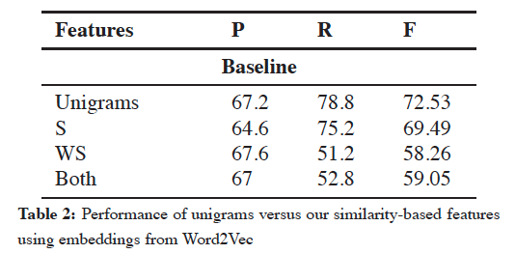
Results
Baseline sets of features:
Unigrams
unweighted similarity using word embeddings (S)
weighted similarity using word embeddings (WS)
S + WS

Slide 13
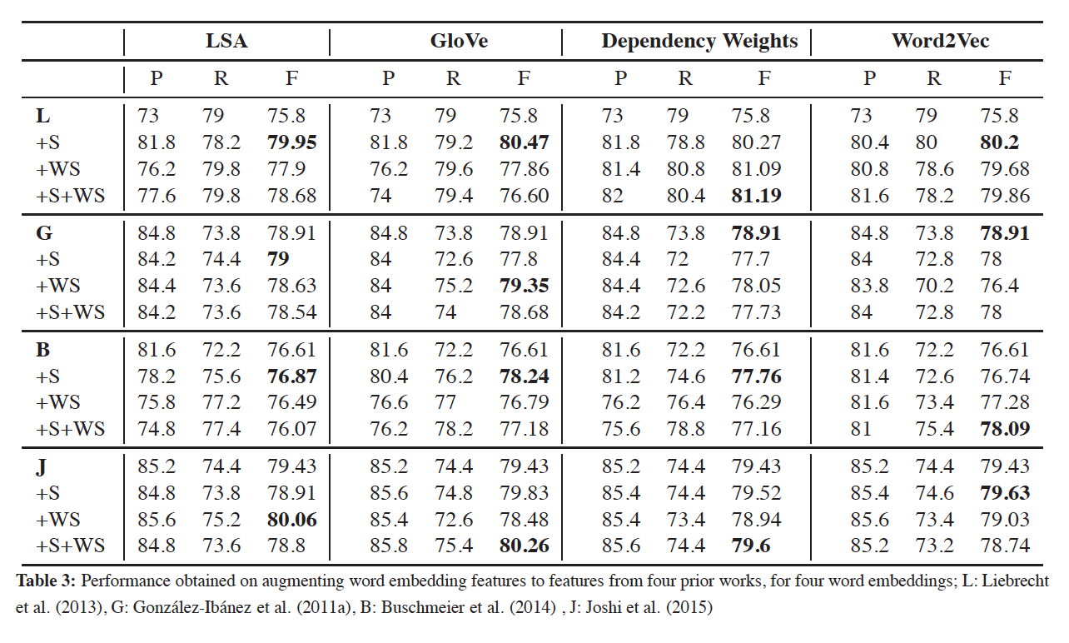
Results

Slide 14
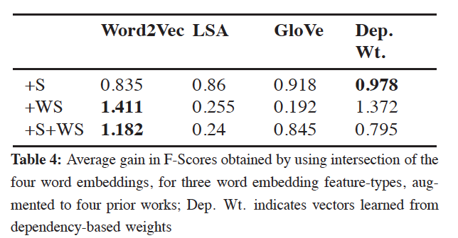
Results
The improvement holds across the four word embedding types as well
The maximum improvement is observed in case of Liebrecht et al. (2013)
4% in case of LSA, 5% in case of GloVe, 6% in case of Dependency weight-based, 4% in case of Word2Vec
These improvements are not directly comparable
The four embeddings have different vocabularies and vocabulary sizes
We take an intersection of the vocabulary and repeat all our experiments using these intersection files
vocabulary size: 60,252
Each gain value is averaged over the four prior works

Slide 15
Error Analysis
Embedding issues due to incorrect senses
Words may have multiple senses, some embeddings lead to error
as in ‘Great. Relationship advice from one of America’s most wanted.’.
Contextual sarcasm
Consider the sarcastic quote ‘Oh, and I suppose the apple ate the cheese’.
The similarity score between ‘apple’ and ‘cheese’ is 0.4119. This comes up as the maximum similar pair.
The most dissimilar pair is ‘suppose’ and ‘apple’ with similarity score of 0.1414.
The sarcasm in this sentence can be understood only in context of the complete conversation that it is a part of.
Metaphors in non-sarcastic text
Figurative(比喻的) language may compare concepts that are not directly related but still have low similarity.
Consider the non sarcastic quote ‘Oh my love, I like to vanish in you like a ripple vanishes in an ocean - slowly, silently and endlessly’.
Our system incorrectly predicts this as sarcastic.

Slide 16
Reference
Joshi, A., Tripathi, V., Patel, K., Bhattacharyya, P., & Carman, M. (2016). Are word embedding-based features useful for sarcasm detection?.

